Slide 1
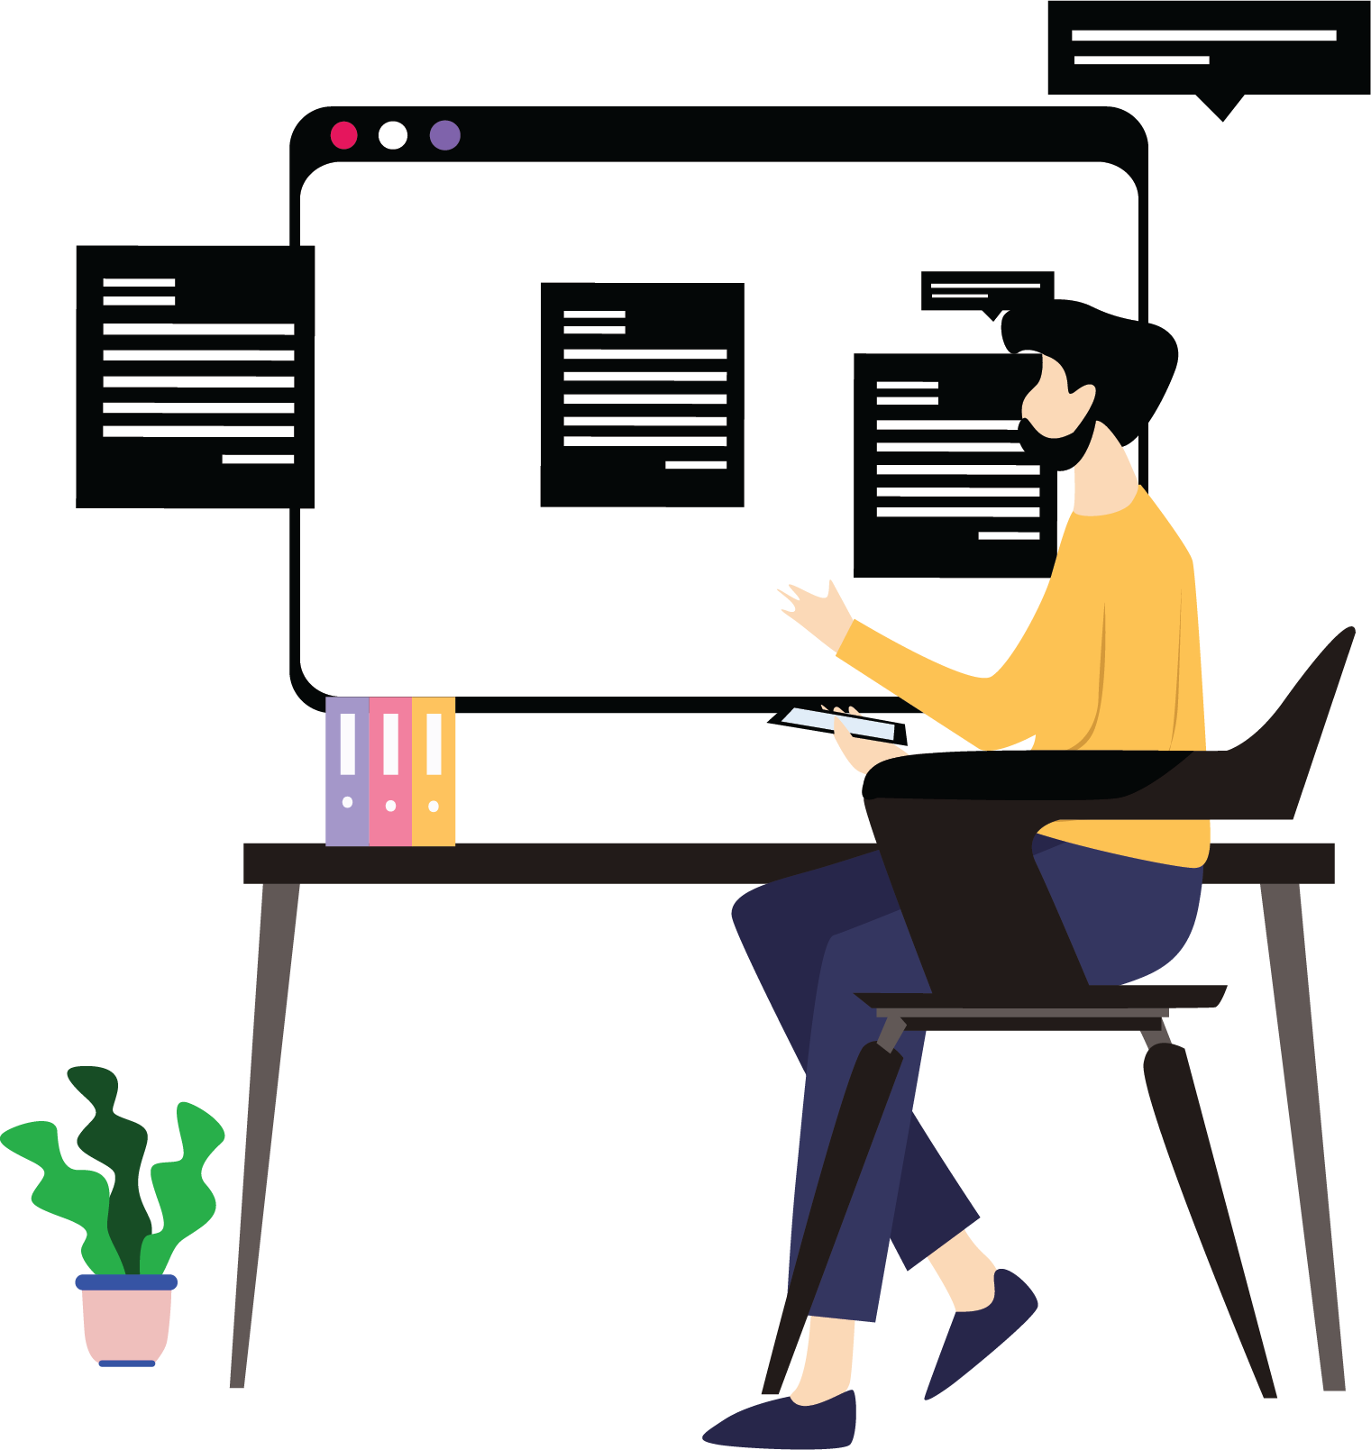
Capstone Project –My Work Planner-Kanban Board

Slide 2
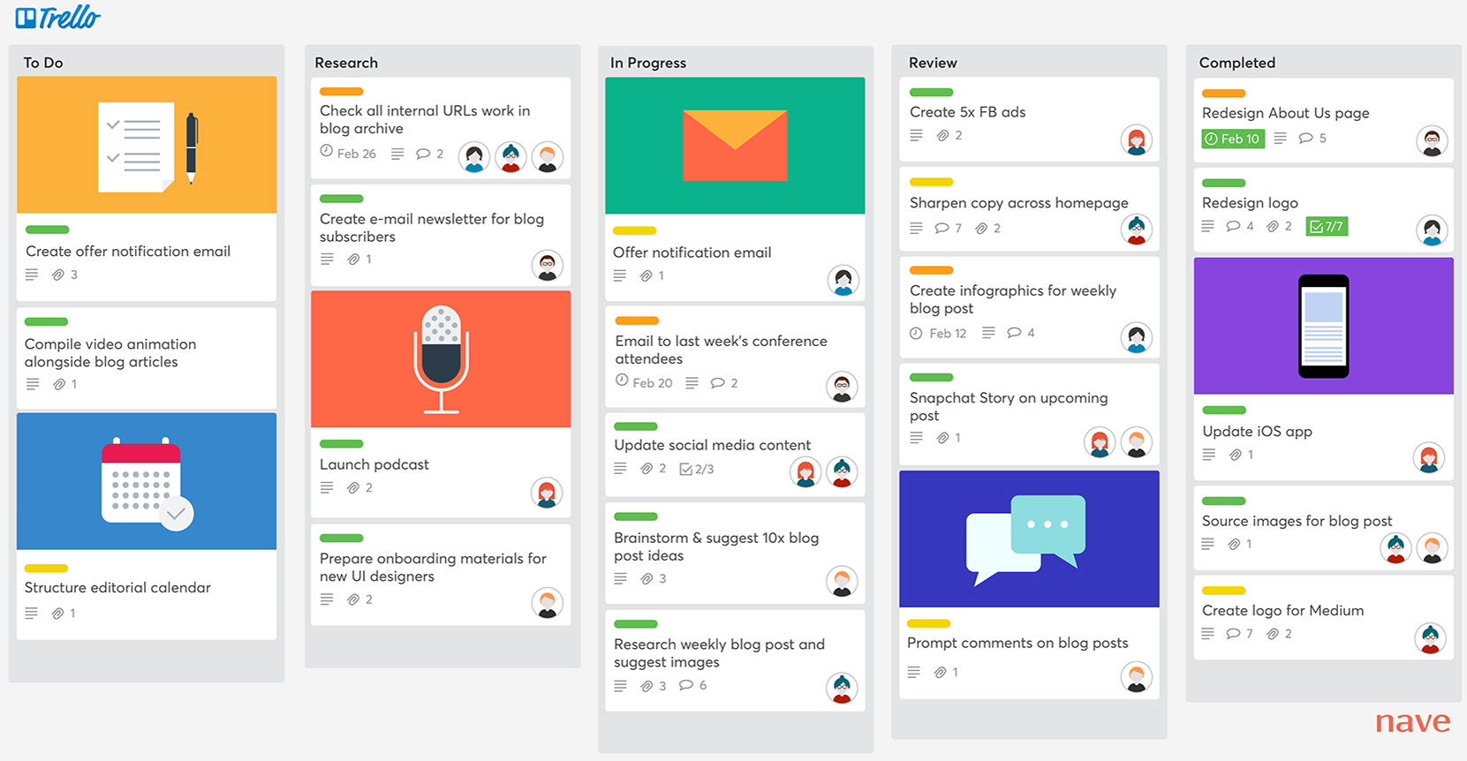
My Work Planner- Kanban Board
A Kanban board is an agile project management tool designed to help visualize work, limit work-in-progress, and maximize the efficiency of a team.
The Kanban boards use cards, columns, and continuous improvement to help technology and service teams complete their work on time and track the progress of individual team members.
"Kanban" is the Japanese word for "visual signal."
https://getnave.com/blog/trello-kanban-boards/

Slide 3
Project Requirements

Slide 4
What Does the Kanban Board Do?
Quick Add:
Visually represent the tasks in a card. Each card contains information about the task at hand, and its status, such as deadline, assignee, description, etc.
Projects and Goals:
Each column on the board represents a different stage of the workflow (to-be done, in-progress, completed). The cards go through the workflow until their full completion.
Work-in-Progress Limits:
Restrict the maximum number of tasks assigned to a particular team member in the different stages of the workflow. Limiting the WIP allows us to finish work items faster. It helps the team focus only on the current tasks.

Slide 5
What Does the Kanban Board Do? (contd.)
Highlight tasks:
Highlights the most important tasks with color-coded priority levels.
Move tasks on priority:
Shift the cards containing tasks based on the status. For example, if a task is not of high-priority then we can shift the task from in-progress to to-be done.

Slide 6
Work Planning

Slide 7
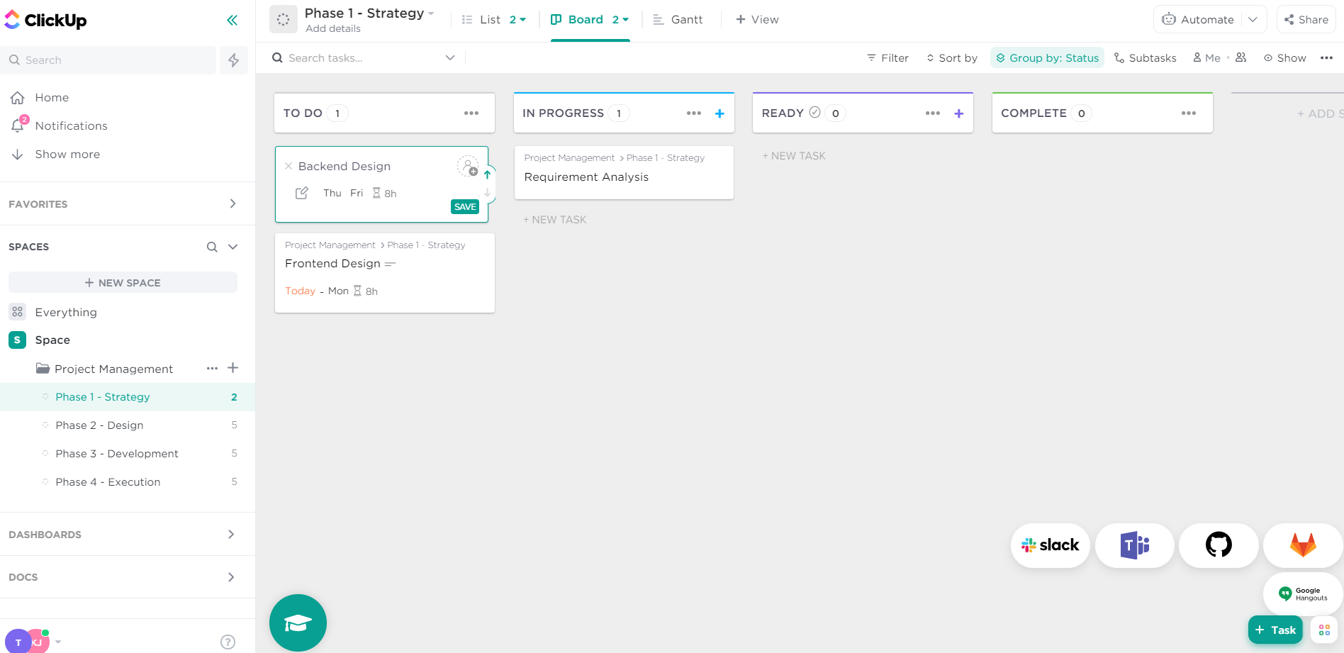
Agile Work Planning Tool
Use the click up app to track your project status and collaborate among team members.
One of the team member must be a scrum master for this sprint. Choose a person from the team.
Include the mentor also as a team member in the project.
Use the below link
https://app.clickup.com/

Slide 8
Evaluation Guidelines
Style Guidelines – Use any of the frontend technologies like HTML, CSS, Bootstrap, Angular Material, etc.
Frontend Design – Build modular, reusable and smart components
Backend Design – Create the design patterns of microservices.
Testing – Test the layers of microservices and E2E testing.
Database – Model the database.
Containerization – Use the docker compose tool.
Engineering Practices – Follow practices that ensure good code quality.

